Slide 1
Parking Management in a Mall

Slide 2
Objective
Detects parking space availability using IoT sensors.
Provides real-time updates of parking spots through a web application.
Displaying the availability .
Integrates AWS services such as DynamoDB, Lambda, and IoT Core for backend management

Slide 3
SYSTEM ARCHITECTURE
1. IoT Devices (Ultrasonic Sensors): These sensors detect whether a parking spot is occupied or available.
2. AWS IoT Core: Facilitates the communication between IoT devices and the cloud infrastructure.
3. AWS Lambda: Executes the serverless backend logic, including sensor data handling, database interactions, and API responses.
4. DynamoDB: A NoSQL database used to store parking space data, including real-time sensor status and reservation information.
5. API Gateway: Exposes API endpoints for the web application to interact with the backend.
6. Web Application (Frontend): Displays real-time parking information

Slide 4
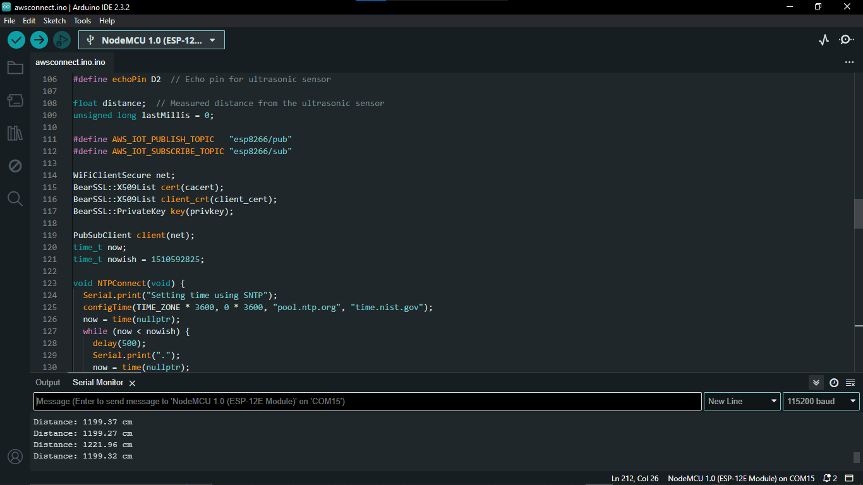
Arduino IDE program for Esp8266

Slide 5
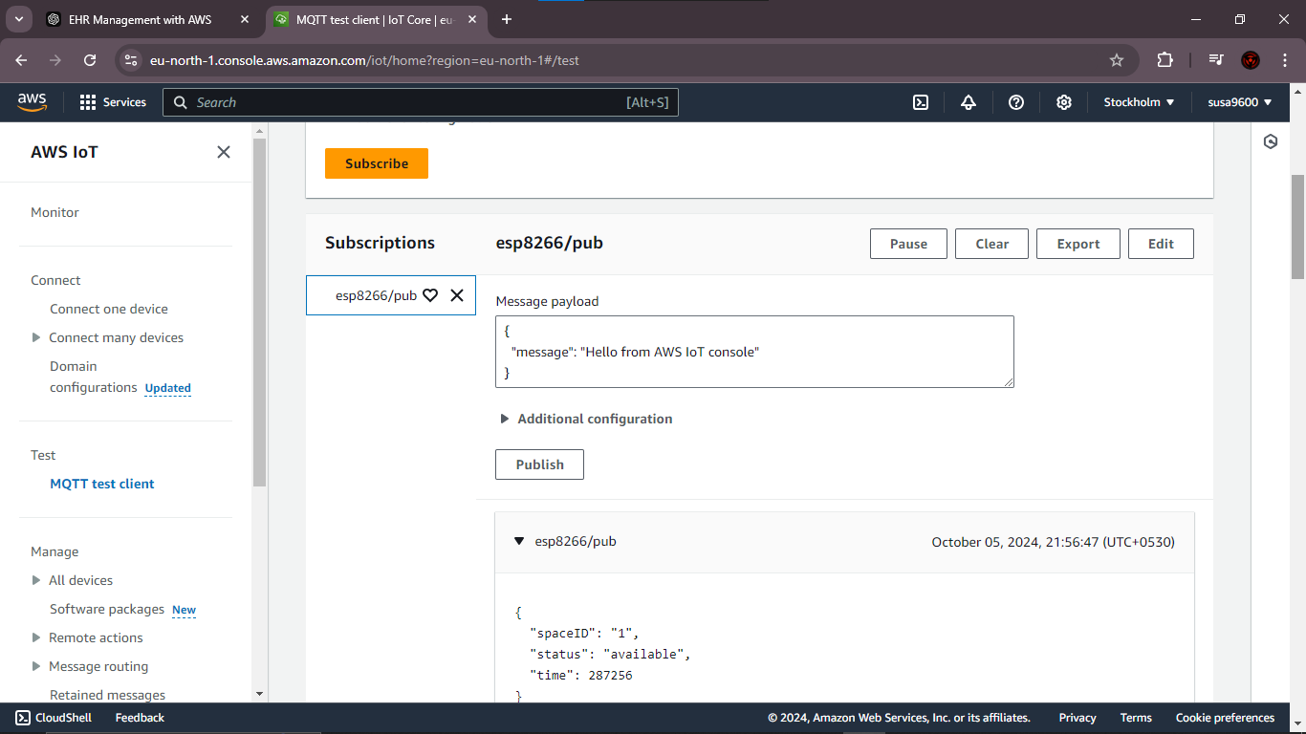
Aws IOT Core - MQTT

Slide 6
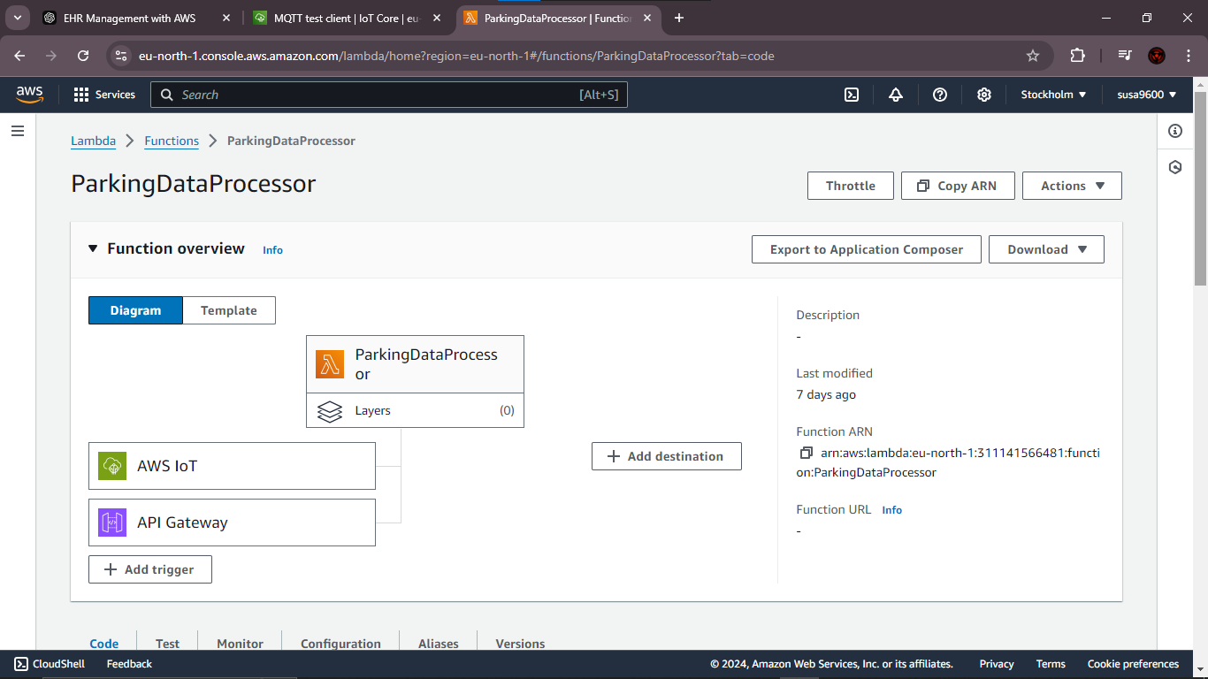
Lambda – parking data

Slide 7
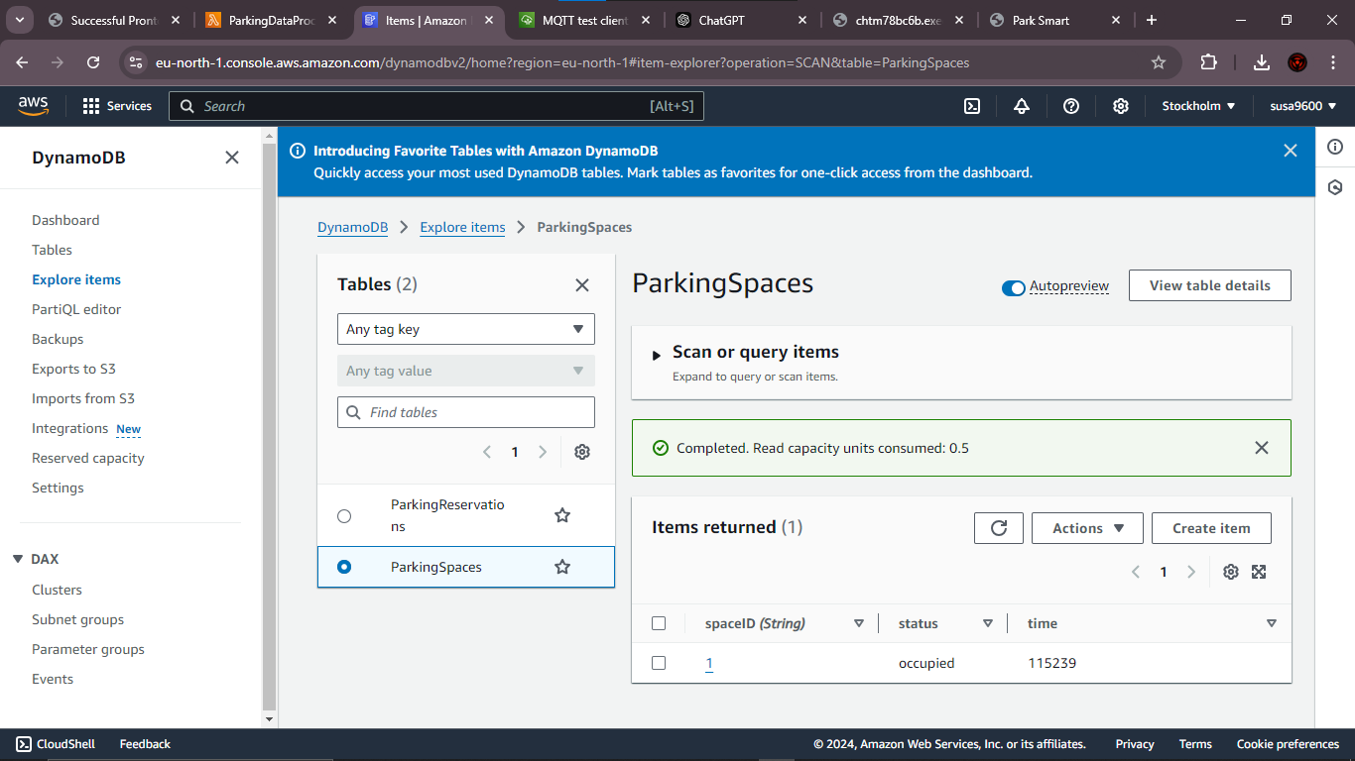
DynamoDB – for Parking Data

Slide 8
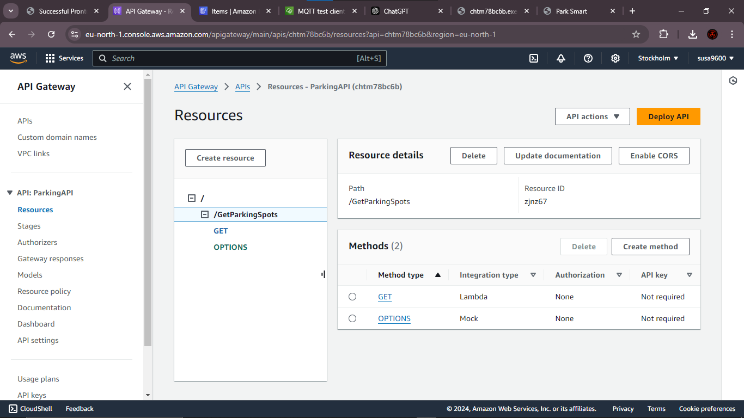
API gateway – parking data

Slide 9
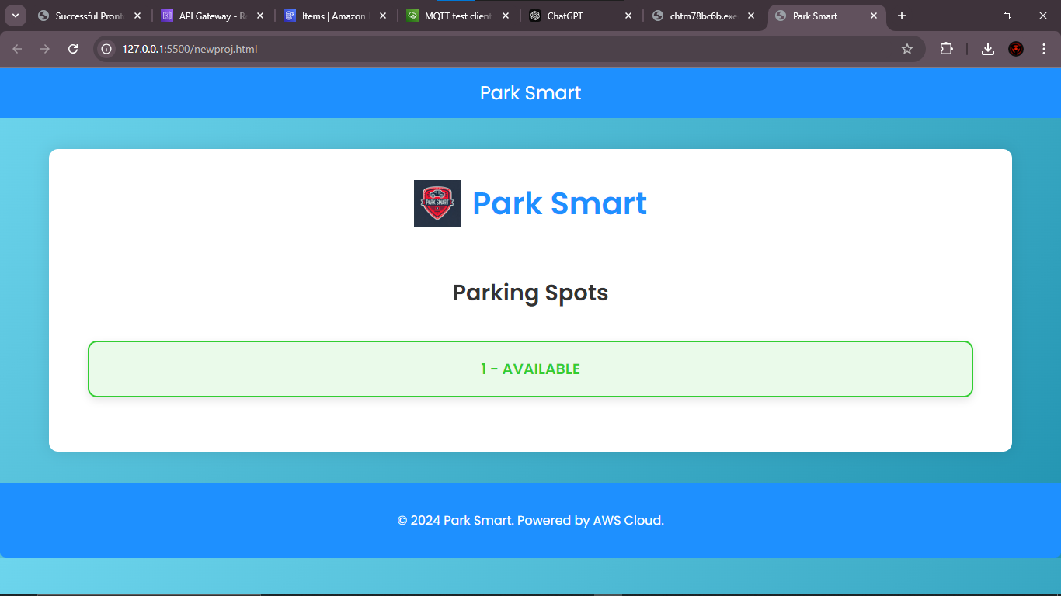
Web

Slide 10
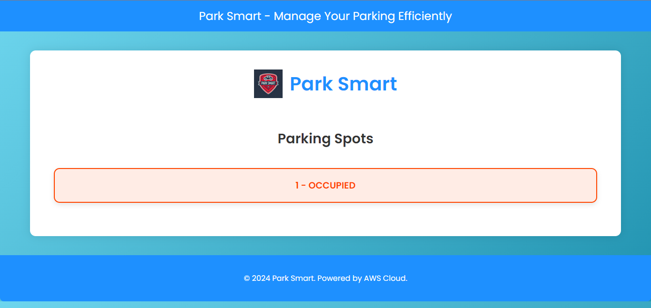
Web

Slide 11
